Slide 1
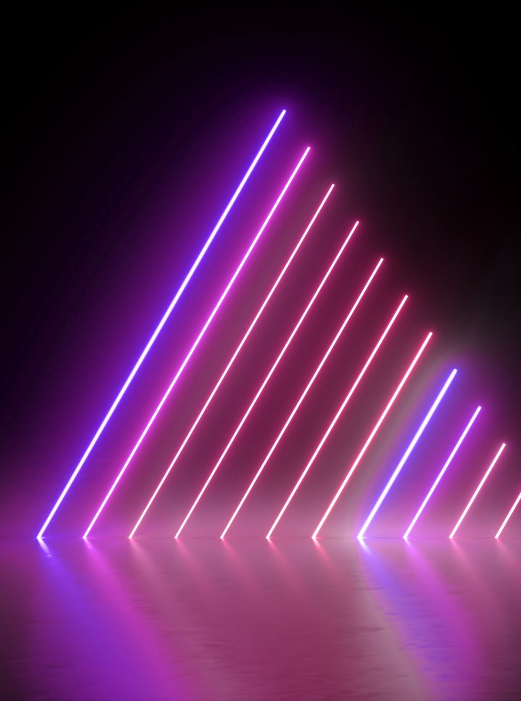
Electrical and Electronic Engineering Principles 1
UWEBIC IY424
Mohammad Hosseinabady
mohammad@highlevel-synthesis.com

Slide 2
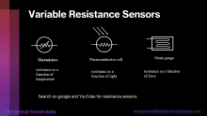
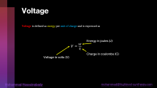
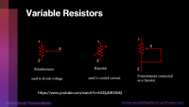
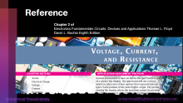
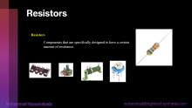
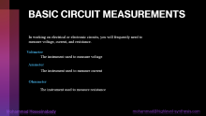
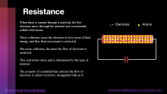
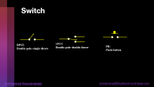
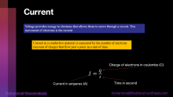
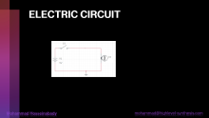
Today’s Topics

Slide 3
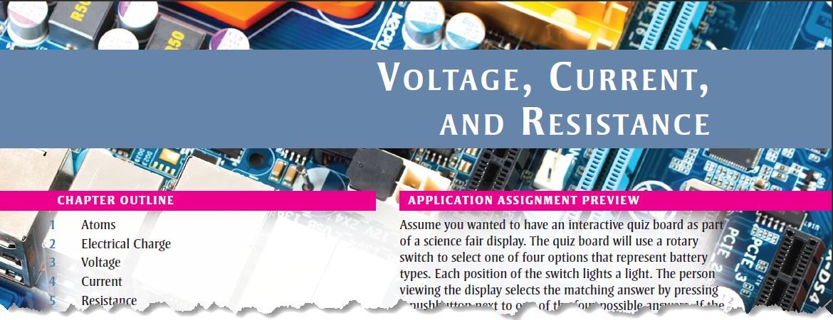
Reference
Chapter 2 of
Electronics Fundamentals Circuits, Devices and Applications Thomas L. Floyd David L. Buchla Eighth Edition

Slide 4
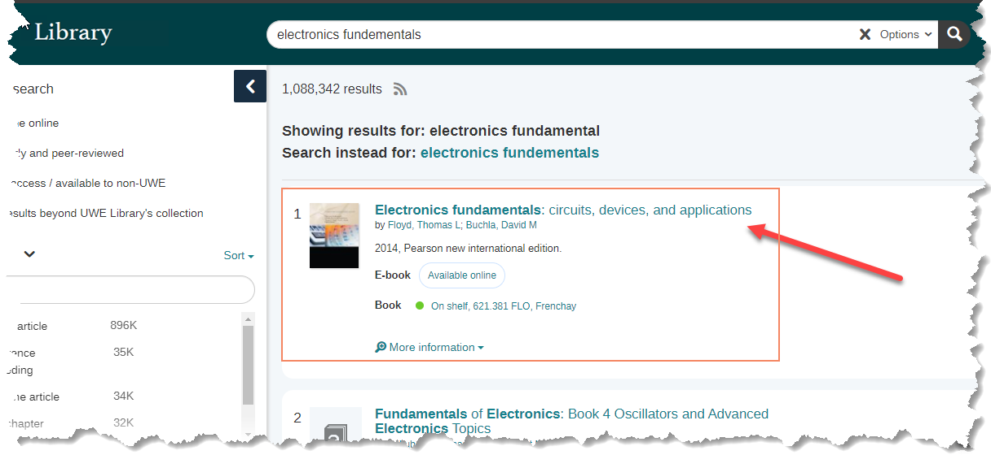
Find the Book in the UWE Library
https://uwe.summon.serialssolutions.com/search?q=electronics+fundementals#!/search?ho=t&l=en-UK&q=electronics%20fundementals

Slide 5

Voltage
Voltage is defined as energy per unit of charge and is expressed as
Energy in joules (J)
$V=\frac{W}{Q}$
Charge in coulombs (C)
Voltage in volts (V)

Slide 6


Example
If $50 J$ of energy are required to move$10 C$ of charge, what is the voltage?
$$V=\frac{w}{Q}=\frac{50 J}{10 C}=5 V$$
How much energy is required to move 50 C from one point in a circuit to another
when the voltage between the two points is 12 V?
Answer: $600 J$

Slide 7

DC Voltage Source
A voltage source provides electrical energy.
An ideal voltage source can provide a constant voltage
for any current required by a circuit.
+
$$V_{S}$$
-
Voltage Source
DC
AC

Slide 8
DC Voltage Source
Types of DC Voltage Sources
Batteries
Fuel Cells
Solar Cells
Generators
The Power Supply
Thermocouple
Piezoelectric Sensors

Slide 9

Current
Voltage provides energy to electrons that allows them to move through a circuit. This movement of electrons is the current
Current in a conductive material is measured by the number of electrons (amount of charge) that flow past a point in a unit of time.
Charge of electrons in coulombs (C)
$I=\frac{Q}{t}$
Current in amperes (A)
Time in second

Slide 10



Example
Ten coulombs of charge flow past a given point in a wire in $2 s$. What is the current in amperes?
$$I=\frac{Q}{t}=\frac{10 C}{2 s}=5 A$$
If there are $8 A$of direct current through the filament of a light bulb, how many
coulombs have moved through the filament in 1.5 s?
Answer: $12 C$

Slide 11
Current Source
An ideal current source can provide a constant current in any load.
Symbol

Slide 12
Resistance
When there is current through a material, the free electrons move through the material and occasionally collide with atoms.
These collisions cause the electrons to lose some of their energy, and thus their movement is restricted.
The more collisions, the more the flow of electrons is restricted.
This restriction varies and is determined by the type of material.
The property of a material that restricts the flow of electrons is called resistance, designated with an R.
Electrons
Atoms

Slide 13




Resistance
Unit of resistance: ohm $Ω$
R
The reciprocal of resistance is conductance: G.
$$G=\frac{1}{R}$$
Resistance/Resistor
Schematic Symbol
The unit of conductance is the siemens: S
Example:
$R= 22kΩ$
$$G=4.5 μS$$

Slide 14
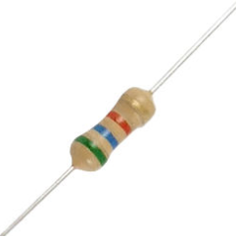
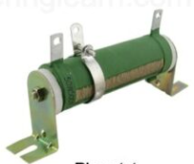
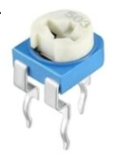
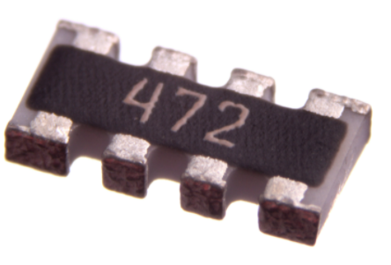
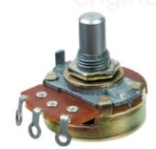
Resistors
Resistors
Components that are specifically designed to have a certain amount of resistance.

Slide 15

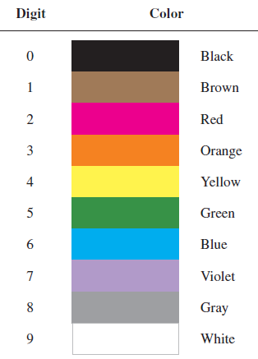
Four Bands Colour Coded Resistors
Resistors
tolerance
1st digit
2nd digit
multiplier (number of zeros following the 2nd digit)

Slide 16



Example
Find the resistance value in ohms and the percent tolerance for this colour-coded resistors.
First band is red 2
Second band is violet 7
Third band is orange 3 zeros,
Fourth band is silver $±10\%$ tolerance.
$$R = 27,000 ±10\%$$

Slide 17

Quiz
Find the resistance value in ohms and the percent tolerance for this colour-coded resistors.
First band is brown 1,
Second band is black 0,
Third band is brown 1 zero,
Fourth band is silver 10% tolerance.
$$R = 100 ±10\%$$

Slide 18

Quiz
Find the resistance value in ohms and the percent tolerance for this colour-coded resistors.
First band is green 5,
Second band is blue 6,
Third band is green 5 zeros,
Fourth band is gold 5% tolerance.
$$R =5,600,000±5\%$$

Slide 19
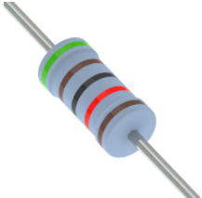
Five Bands Colour Coded Resistors
Resistors
tolerance
1st digit
2nd digit
3rd digit
Multiplier (number of zeros following the 3rd digit)

Slide 20

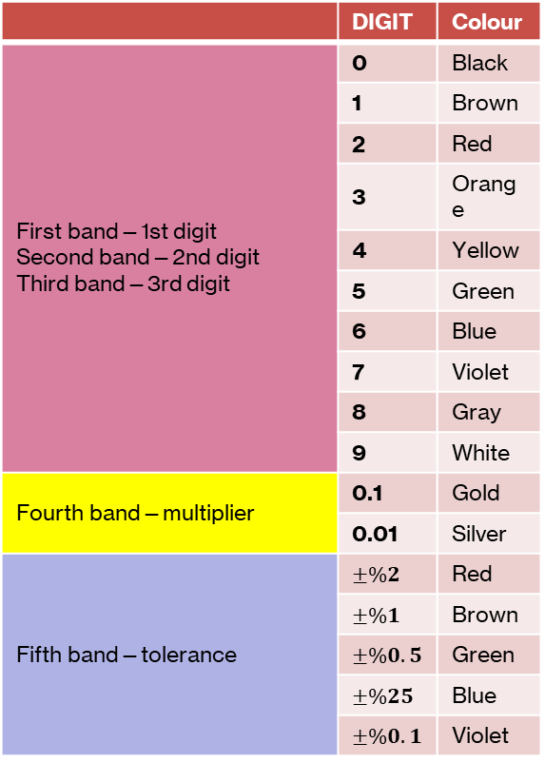

Five Bands Colour Coded Resistors
 | DIGIT | Colour
First band—1st digit Second band—2nd digit Third band—3rd digit | 0 | Black
 | 1 | Brown
 | 2 | Red
 | 3 | Orange
 | 4 | Yellow
 | 5 | Green
 | 6 | Blue
 | 7 | Violet
 | 8 | Gray
 | 9 | White
Fourth band—multiplier | 0.1 | Gold
 | 0.01 | Silver
Fifth band—tolerance | $$±\%2$$ | Red
 | $$±\%1$$ | Brown
 | $$±\%0.5$$ | Green
 | $$±\%25$$ | Blue
 | $$±\%0.1$$ | Violet
First band is red 2,
Second band is violet 7,
Third band is black 0,
Fourth band is gold 0.1,
Fifth band is red 2% tolerance.
$$R = 270 ∗ 0.1 = 27 ±2\%$$

Slide 21



Quiz
 | DIGIT | Colour
First band—1st digit Second band—2nd digit Third band—3rd digit | 0 | Black
 | 1 | Brown
 | 2 | Red
 | 3 | Orange
 | 4 | Yellow
 | 5 | Green
 | 6 | Blue
 | 7 | Violet
 | 8 | Gray
 | 9 | White
Fourth band—multiplier | 0.1 | Gold
 | 0.01 | Silver
Fifth band—tolerance | $$±\%2$$ | Red
 | $$±\%1$$ | Brown
 | $$±\%0.5$$ | Green
 | $$±\%0.25$$ | Blue
 | $$±\%0.1$$ | Violet
First band is yellow 4,
Second band is black 0,
Third band is red 2,
Fourth band is black 0,
Fifth band is brown 1% tolerance.
$$R = 402±1\%$$

Slide 22
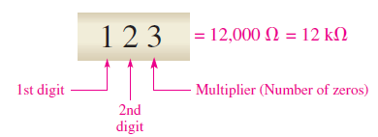

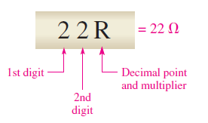
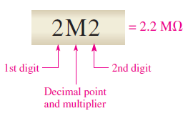
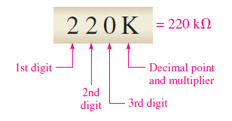
Resistor Label Codes
surface-mount resistors
R: a multiplier of 1 (no zeros after the digits),
K: a multiplier of 1000 (three zeros after the digits),
M: a multiplier of 1,000,000

Slide 23

Quiz
Interpret the following alphanumeric resistor labels:
470
5R6
68K
10M
3M3
Answer
470 = 470 $Ω$
5R6 = 5.6 $Ω$
68K = 68 $kΩ$
(d) 10M = 10 $MΩ$
(e) 3M3 = 3.3 $MΩ$

Slide 24
Variable Resistors
1
1
1
3
3
2
2
Potentiometer
Rheostat
2
used to control current
Potentiometer connected
as a rheostat
used to divide voltage
https://www.youtube.com/watch?v=D4DjJDKO6IQ

Slide 25




Example
1
$$75 Ω$$
$$100Ω$$
3
$$? Ω$$
$$25 Ω$$
2

Slide 26
Variable Resistance Sensors
Thermistors
Photoconductive cell
Strain gauge
resistance as a function of temperature
resistance as a function of light
resistance as a function of force
Search on google and YouTube for resistance sensors

Slide 27
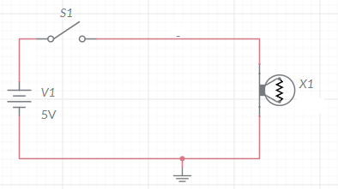
ELECTRIC CIRCUIT

Slide 28


Multisim Simulator
https://www.multisim.com/
A useful tutorial:
https://www.youtube.com/watch?v=gBhlr2AcaR0

Slide 29
Switch
DPST:
Double-pole–single-throw
SPDT:
Double-pole–double-throw
PB:
Push-button

Slide 30

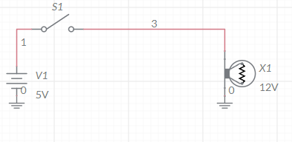
Ground
Ground is the reference point in an electric circuit.
Voltages are always specified with respect to another point.

Slide 31
BASIC CIRCUIT MEASUREMENTS
In working on electrical or electronic circuits, you will frequently need to measure voltage, current, and resistance.
Voltmeter
The instrument used to measure voltage
Ammeter
The instrument used to measure current
Ohmmeter
The instrument used to measure resistance

Slide 32
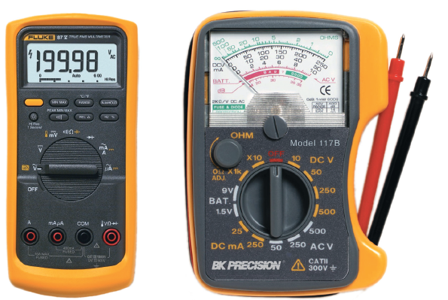
Portable Multimeters
Digital multimeter
Analog multimeter

Slide 33


Measuring Current
+
A
-
+
$$I$$
+
$$I$$
-
-
series connection

Slide 34
Measuring Voltage
+
$$I$$
+
+
V
-
-
-
parallel connection

Slide 35
Measuring Resistance
To measure resistance, connect an ohmmeter across the resistor.
The resistor must first be removed or disconnected from the circuit.

Slide 36
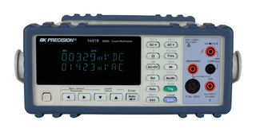
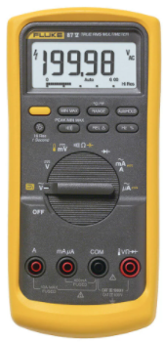
Digital Multimeters (DMMs)
https://www.youtube.com/watch?v=grDoGiSxOP0

Slide 37
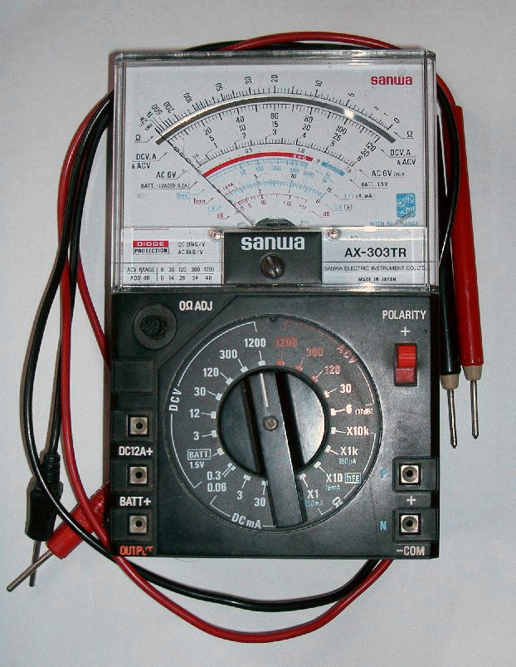
Analog Multimeters (DMMs)
https://www.youtube.com/watch?v=9rGDx92McTY

Slide 38
Quiz
SW
1
+
SW → 1
2
+
V1=0
5v
V1
+
-
V2=5
V2
-
SW → 2
-
V1=5
V2=0

Slide 39
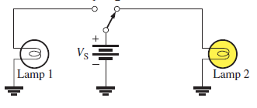
Quiz
Build this circuit in MultisimOnline and simulate that.

Slide 40
Quiz
1- A resistor color coded with brown, black, and orange bands has a value of $10 Ωk$.
Answer: True
2- A normally open push-button switch can carry current when not pushed.
Answer: False

Slide 41



Quiz
Show the placement of an ammeter and a voltmeter to measure the current and the voltage on R1.
+
$R_{1}$
$V_{S}$
-
$R_{2}$

